Slide 1
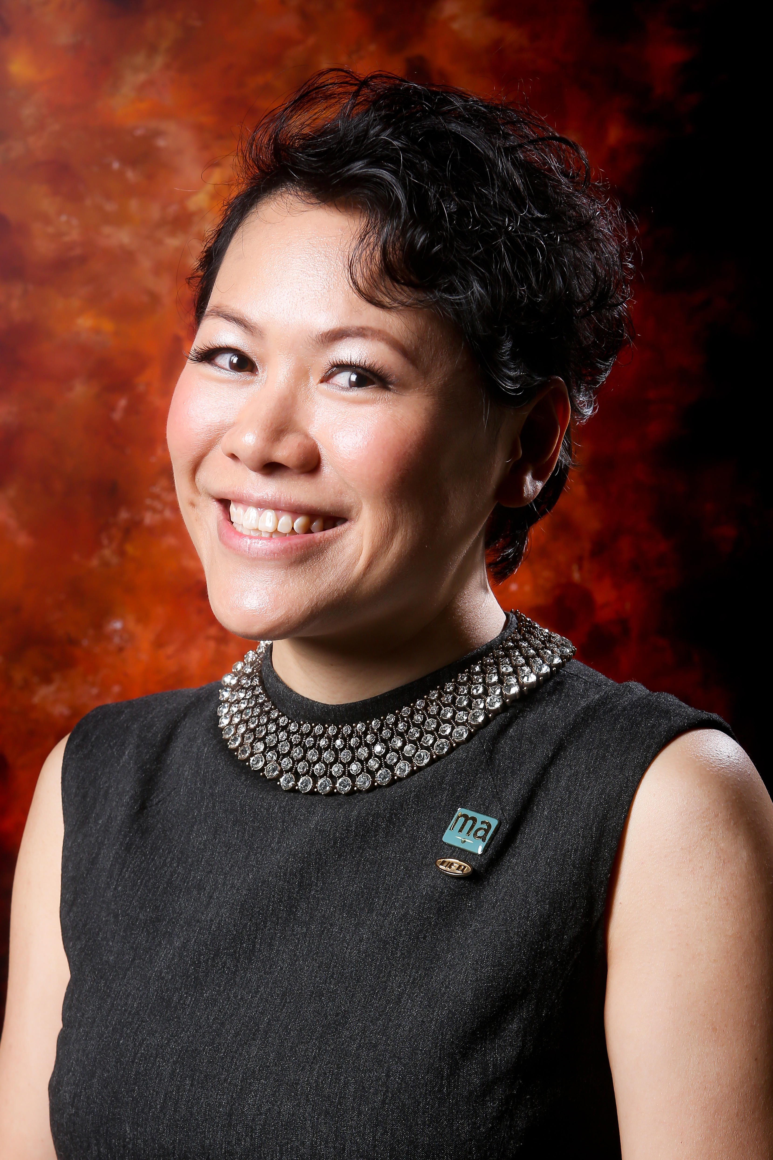
利用Motives建立事業與全新產品發布
Motives Business-Building and New Products
Thorine Mak
專業經理級
Professional Coordinator
四個佣金週期共賺取HK$34,500
HK$34,500 in 4 Commission weeks
本簡報中提到的收入等級純屬舉例說明，無意代表美安香港超連鎖™店主的一般收入，也無意表示任何超連鎖™店主皆可賺取同等收入。美安香港超連鎖™店主的成功與否，取決於其在發展事業時的努力、才能與投入程度。
The income levels mentioned in the following presentation are for illustration purposes only. They are not intended to represent the income of a typical Market Hong Kong UnFranchise ™Owner, nor are they intended to represent that any given Independent UnFranchise ™ Owner will earn income in that amount. The success of any Market Hong Kong Independent UnFranchise ™ Owner will depend upon the amount of hard work, talent, and dedication which he or she devotes to building his or her Market Hong Kong Business.

Slide 12
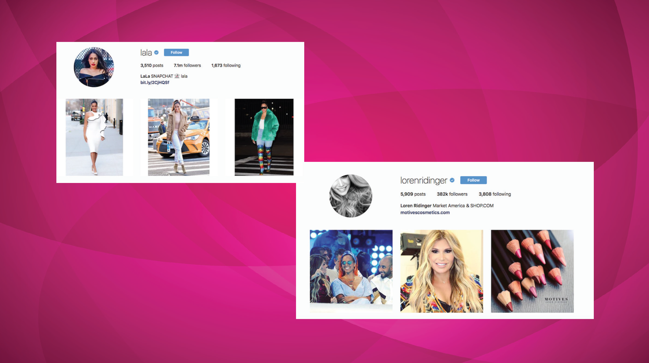

Slide 15
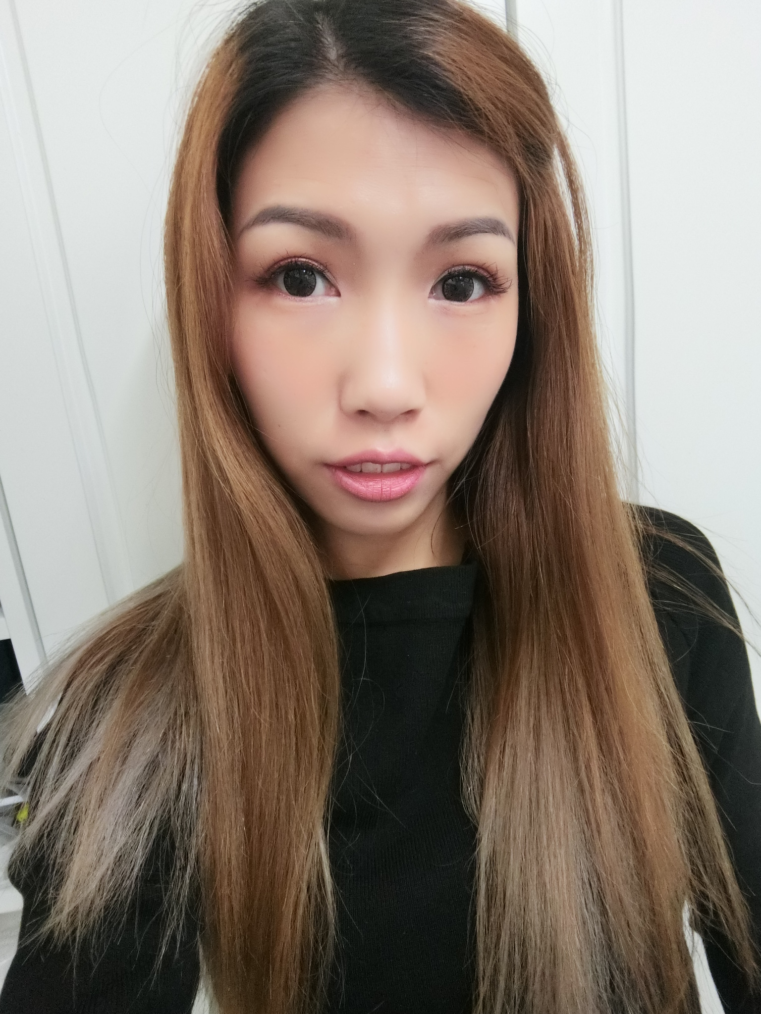
利用Motives建立事業與全新產品發布
Motives Business-Building and New Products
Angie Chou
Meko Lun
專業經理級
Professional Coordinator
資深主管經理級
Senior Master Coordinator
四個佣金週期共賺取HK$34,500
HK$34,500 in 4 Commission weeks
四個佣金週期共賺取HK$23,000
HK$23,000 in 4 Commission weeks
本簡報中提到的收入等級純屬舉例說明，無意代表美安香港超連鎖™店主的一般收入，也無意表示任何超連鎖™店主皆可賺取同等收入。美安香港超連鎖™店主的成功與否，取決於其在發展事業時的努力、才能與投入程度。
The income levels mentioned in the following presentation are for illustration purposes only. They are not intended to represent the income of a typical Market Hong Kong UnFranchise ™Owner, nor are they intended to represent that any given Independent UnFranchise ™ Owner will earn income in that amount. The success of any Market Hong Kong Independent UnFranchise ™ Owner will depend upon the amount of hard work, talent, and dedication which he or she devotes to building his or her Market Hong Kong Business.

Slide 17
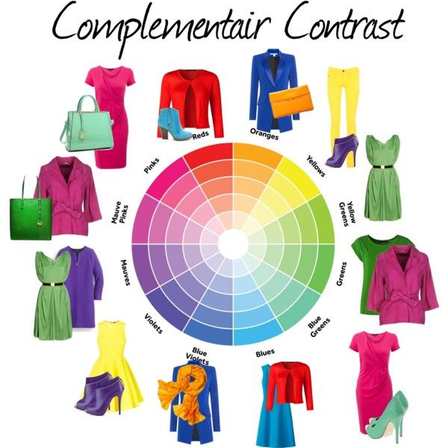

Slide 18
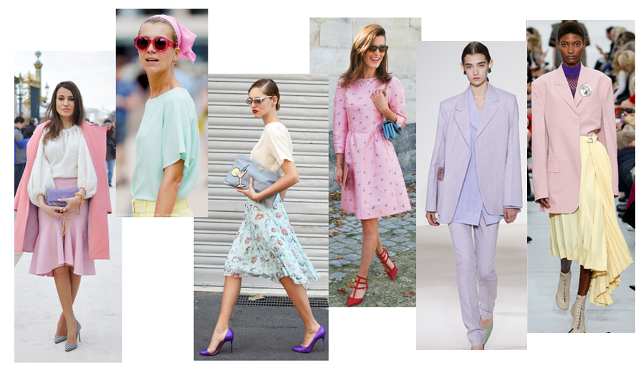

Slide 19
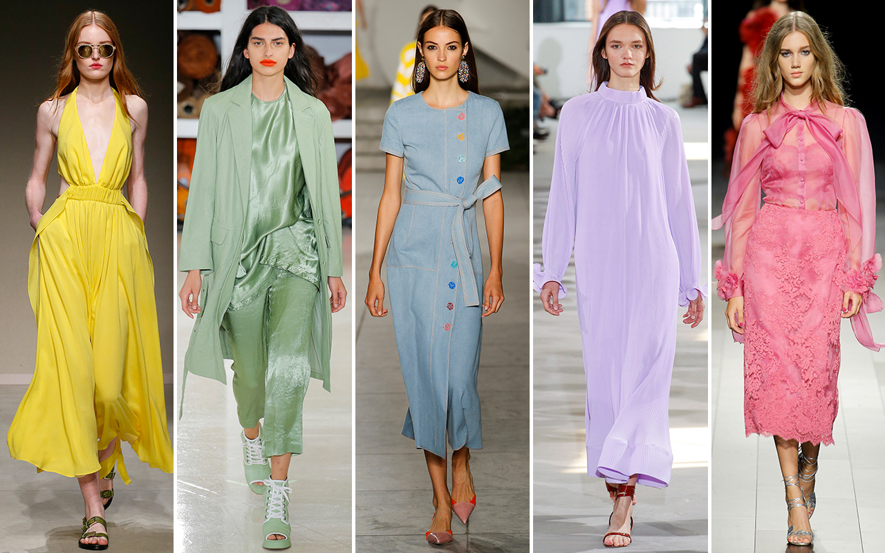

Slide 20
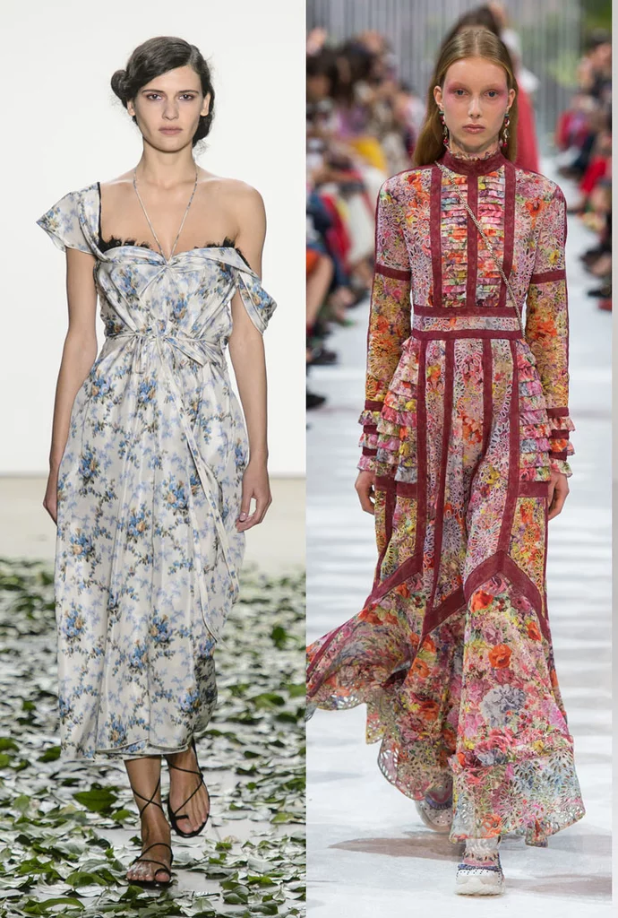
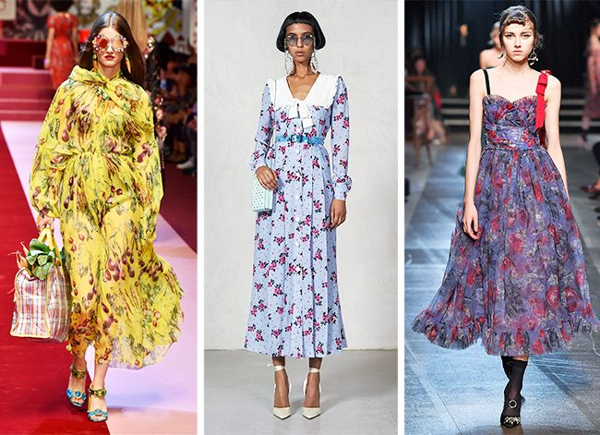

Slide 21
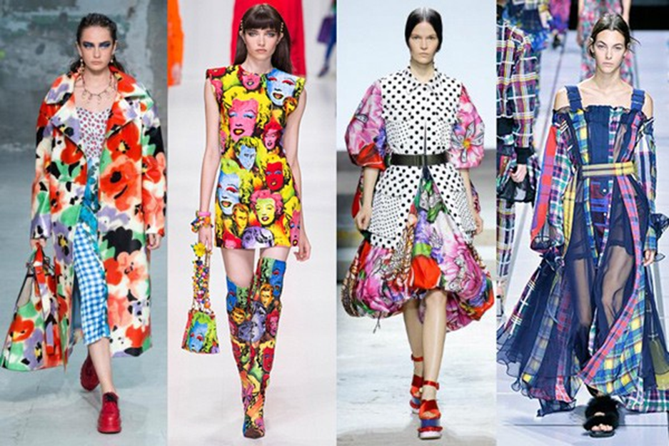

Slide 22
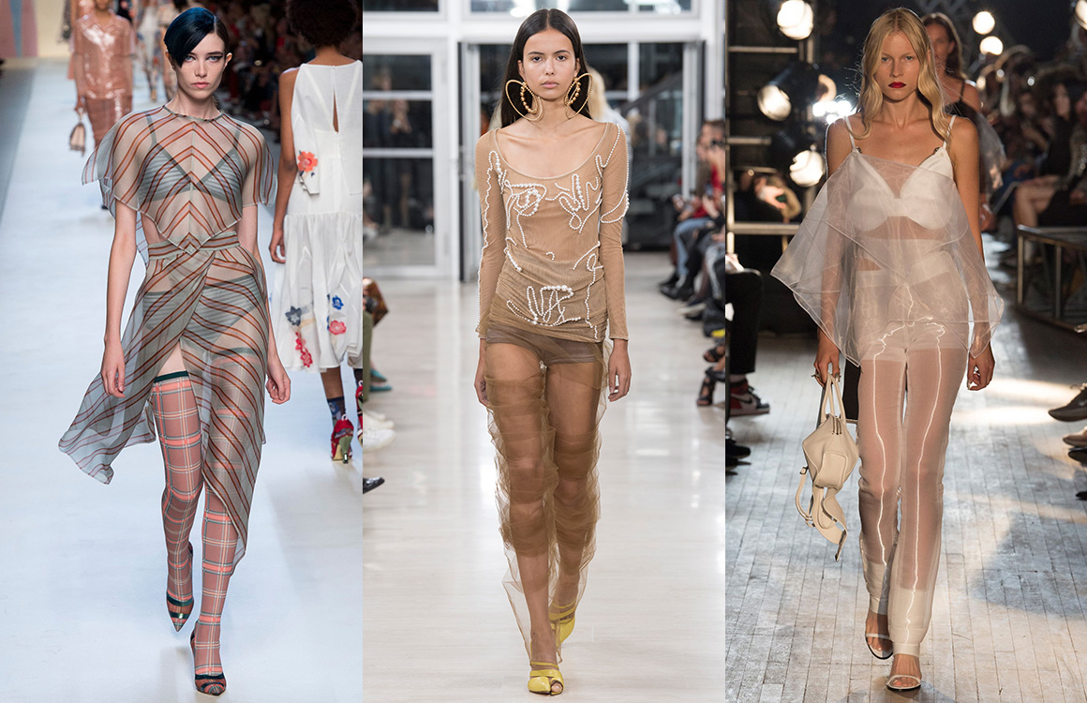
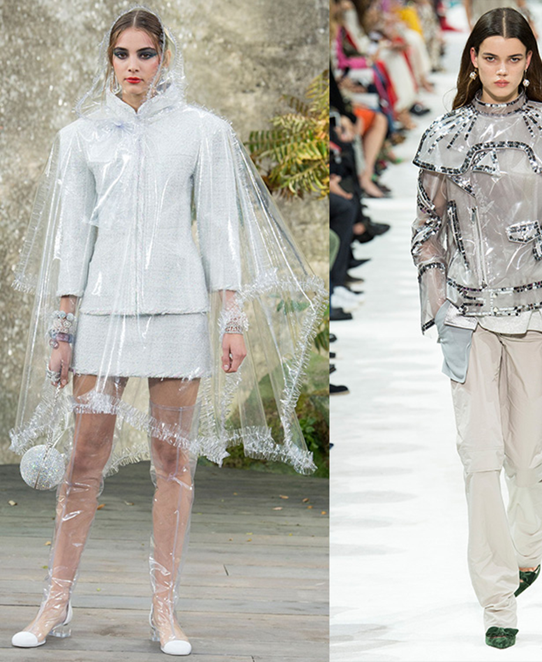

Slide 23
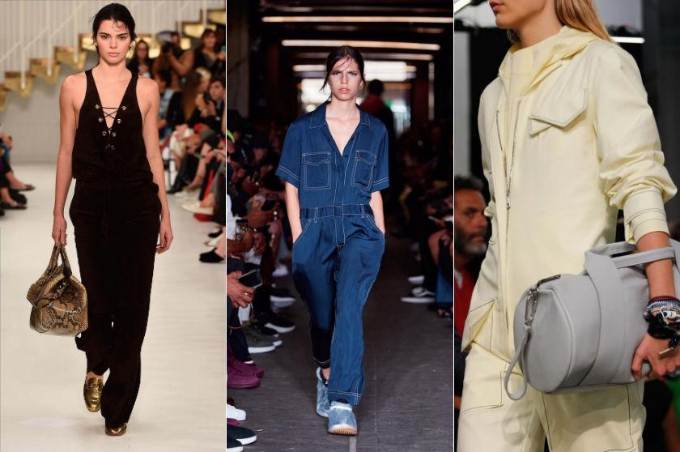

Slide 24
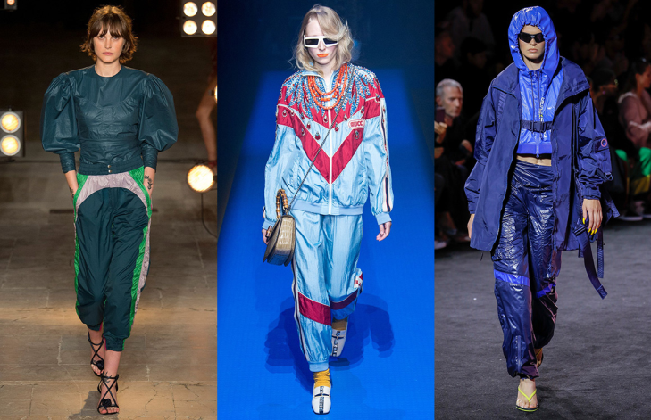
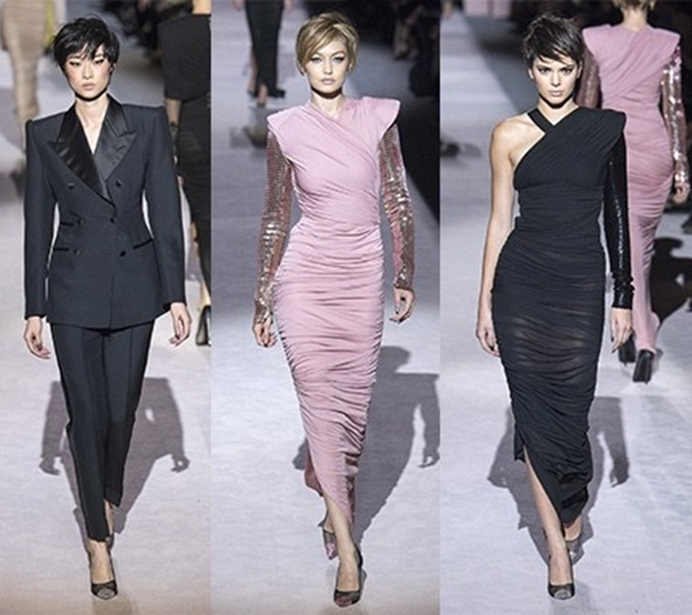
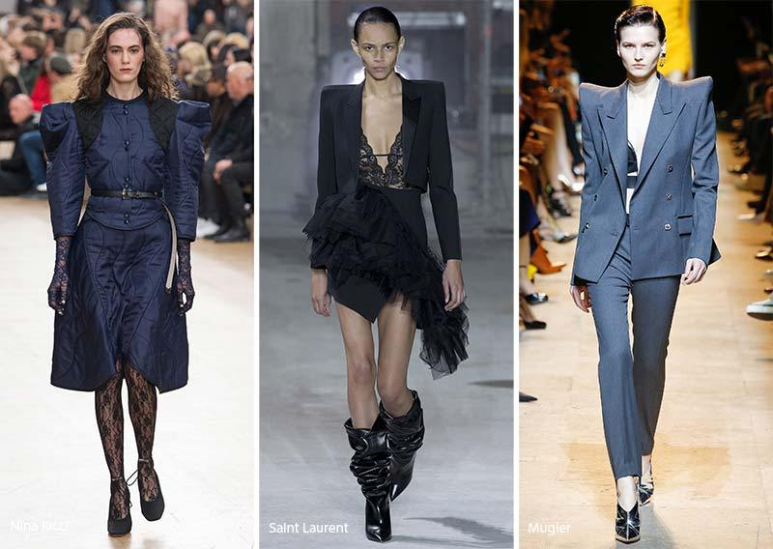

Slide 25
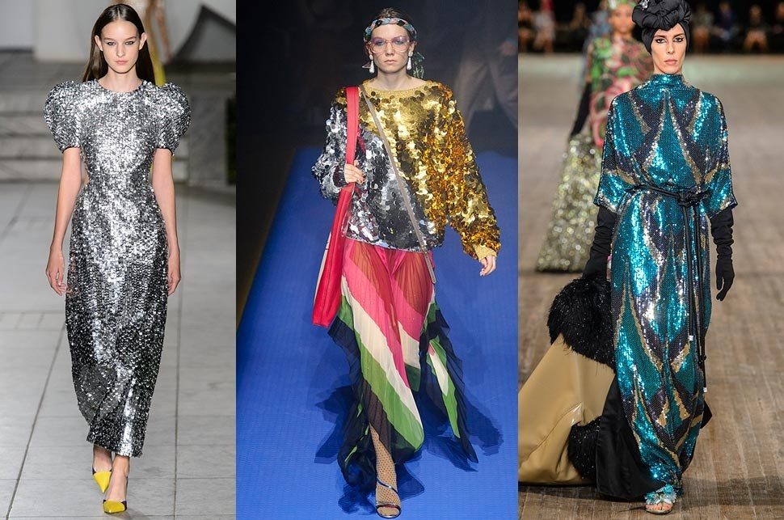
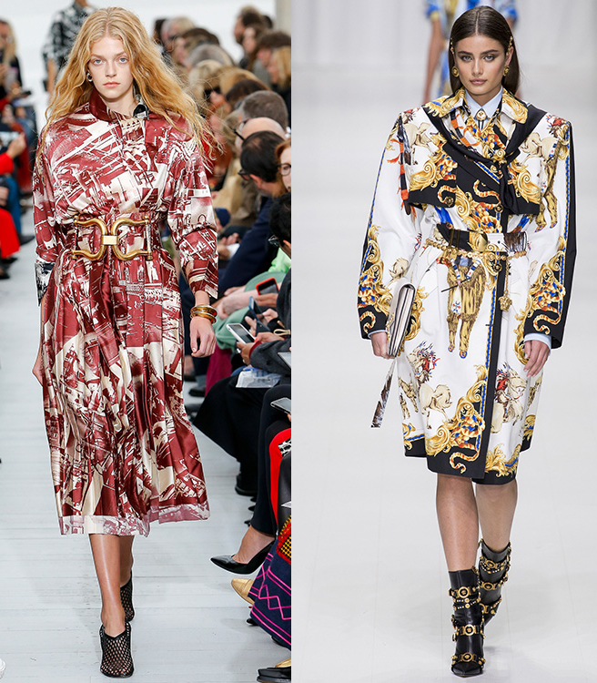

Slide 26
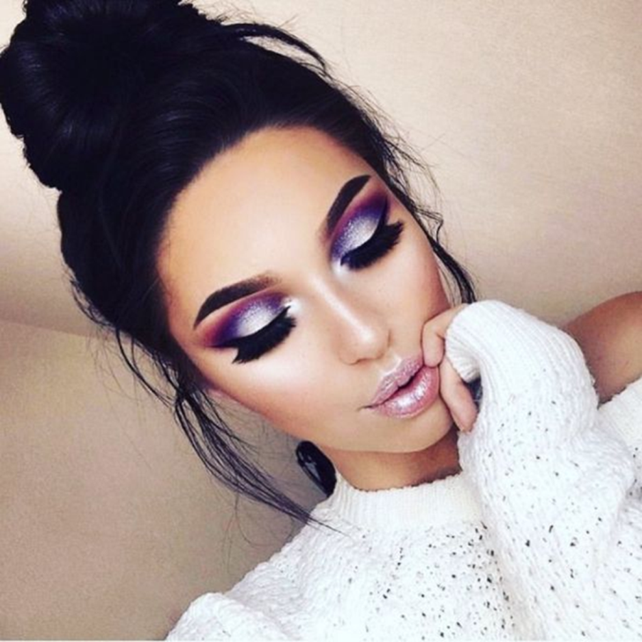

Slide 33
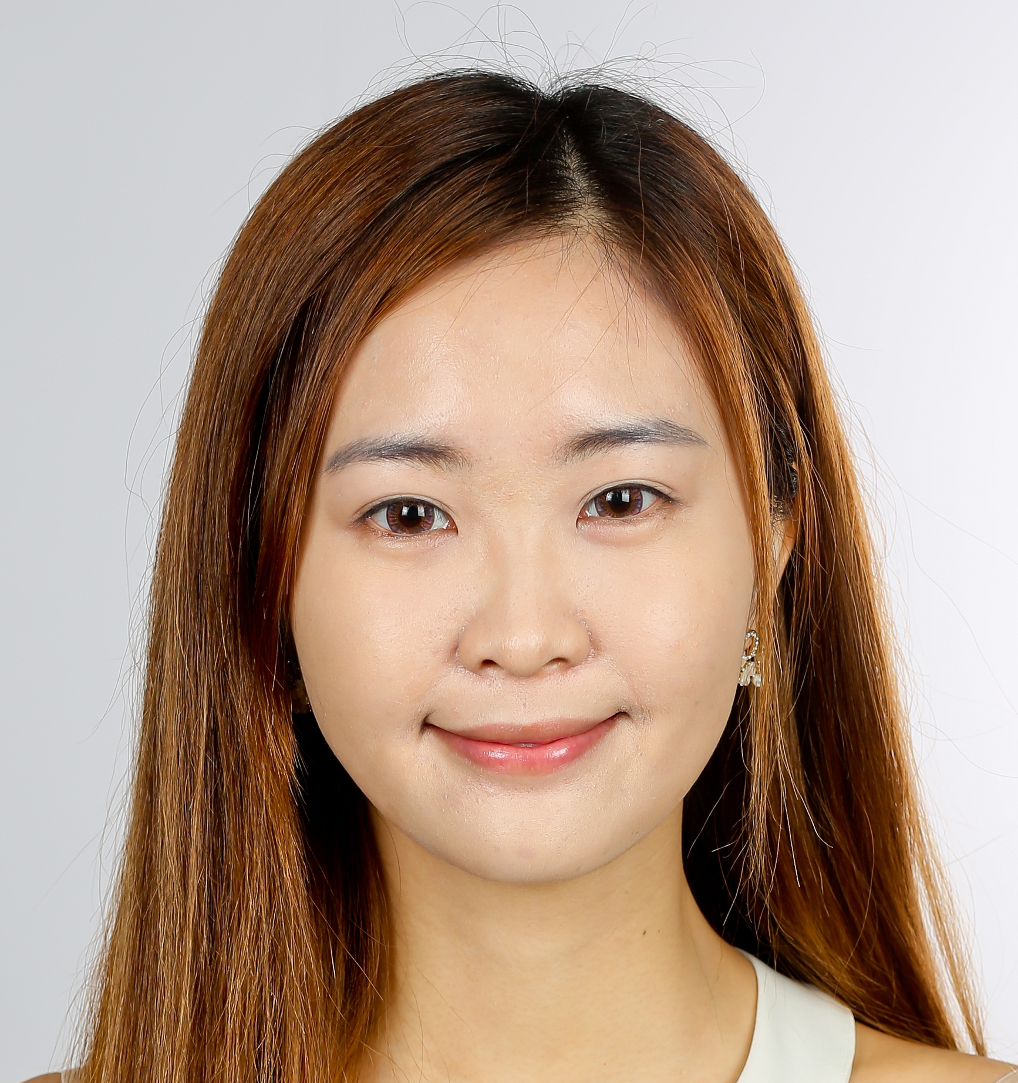

Slide 34
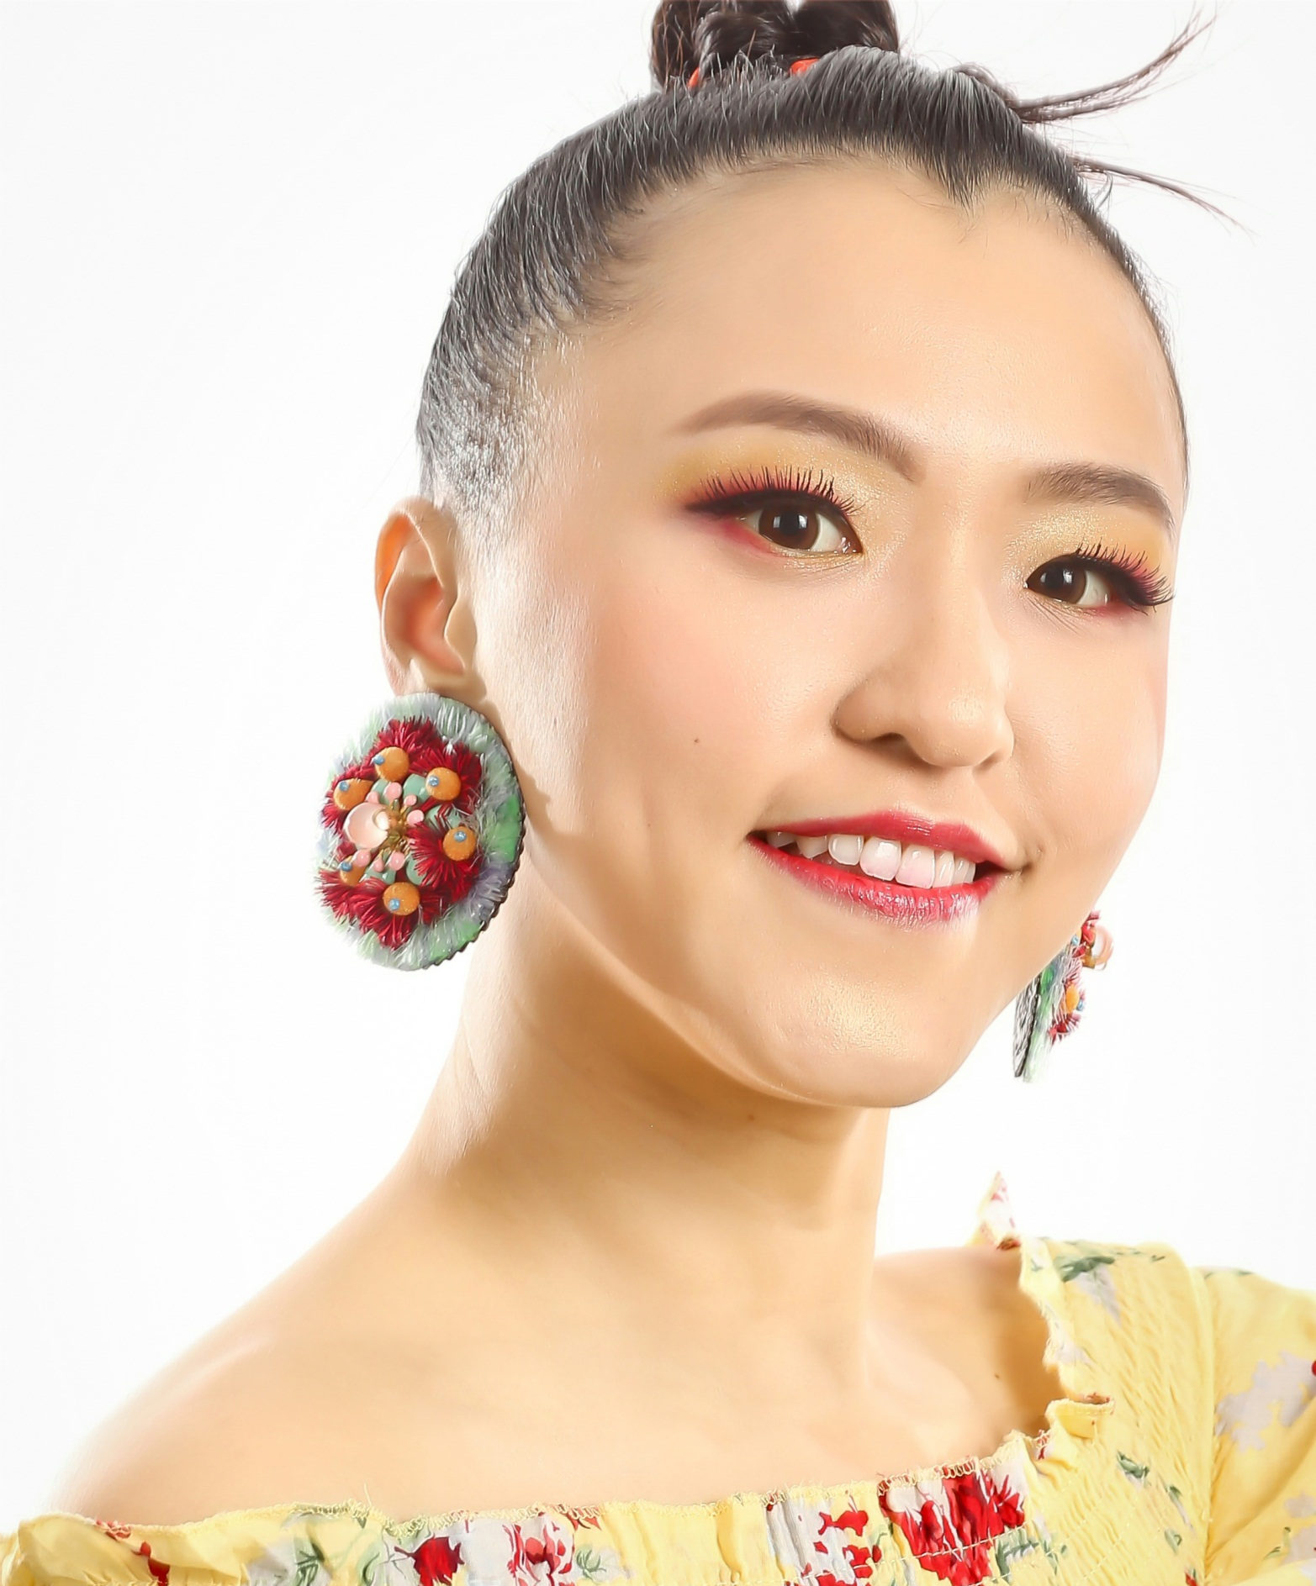
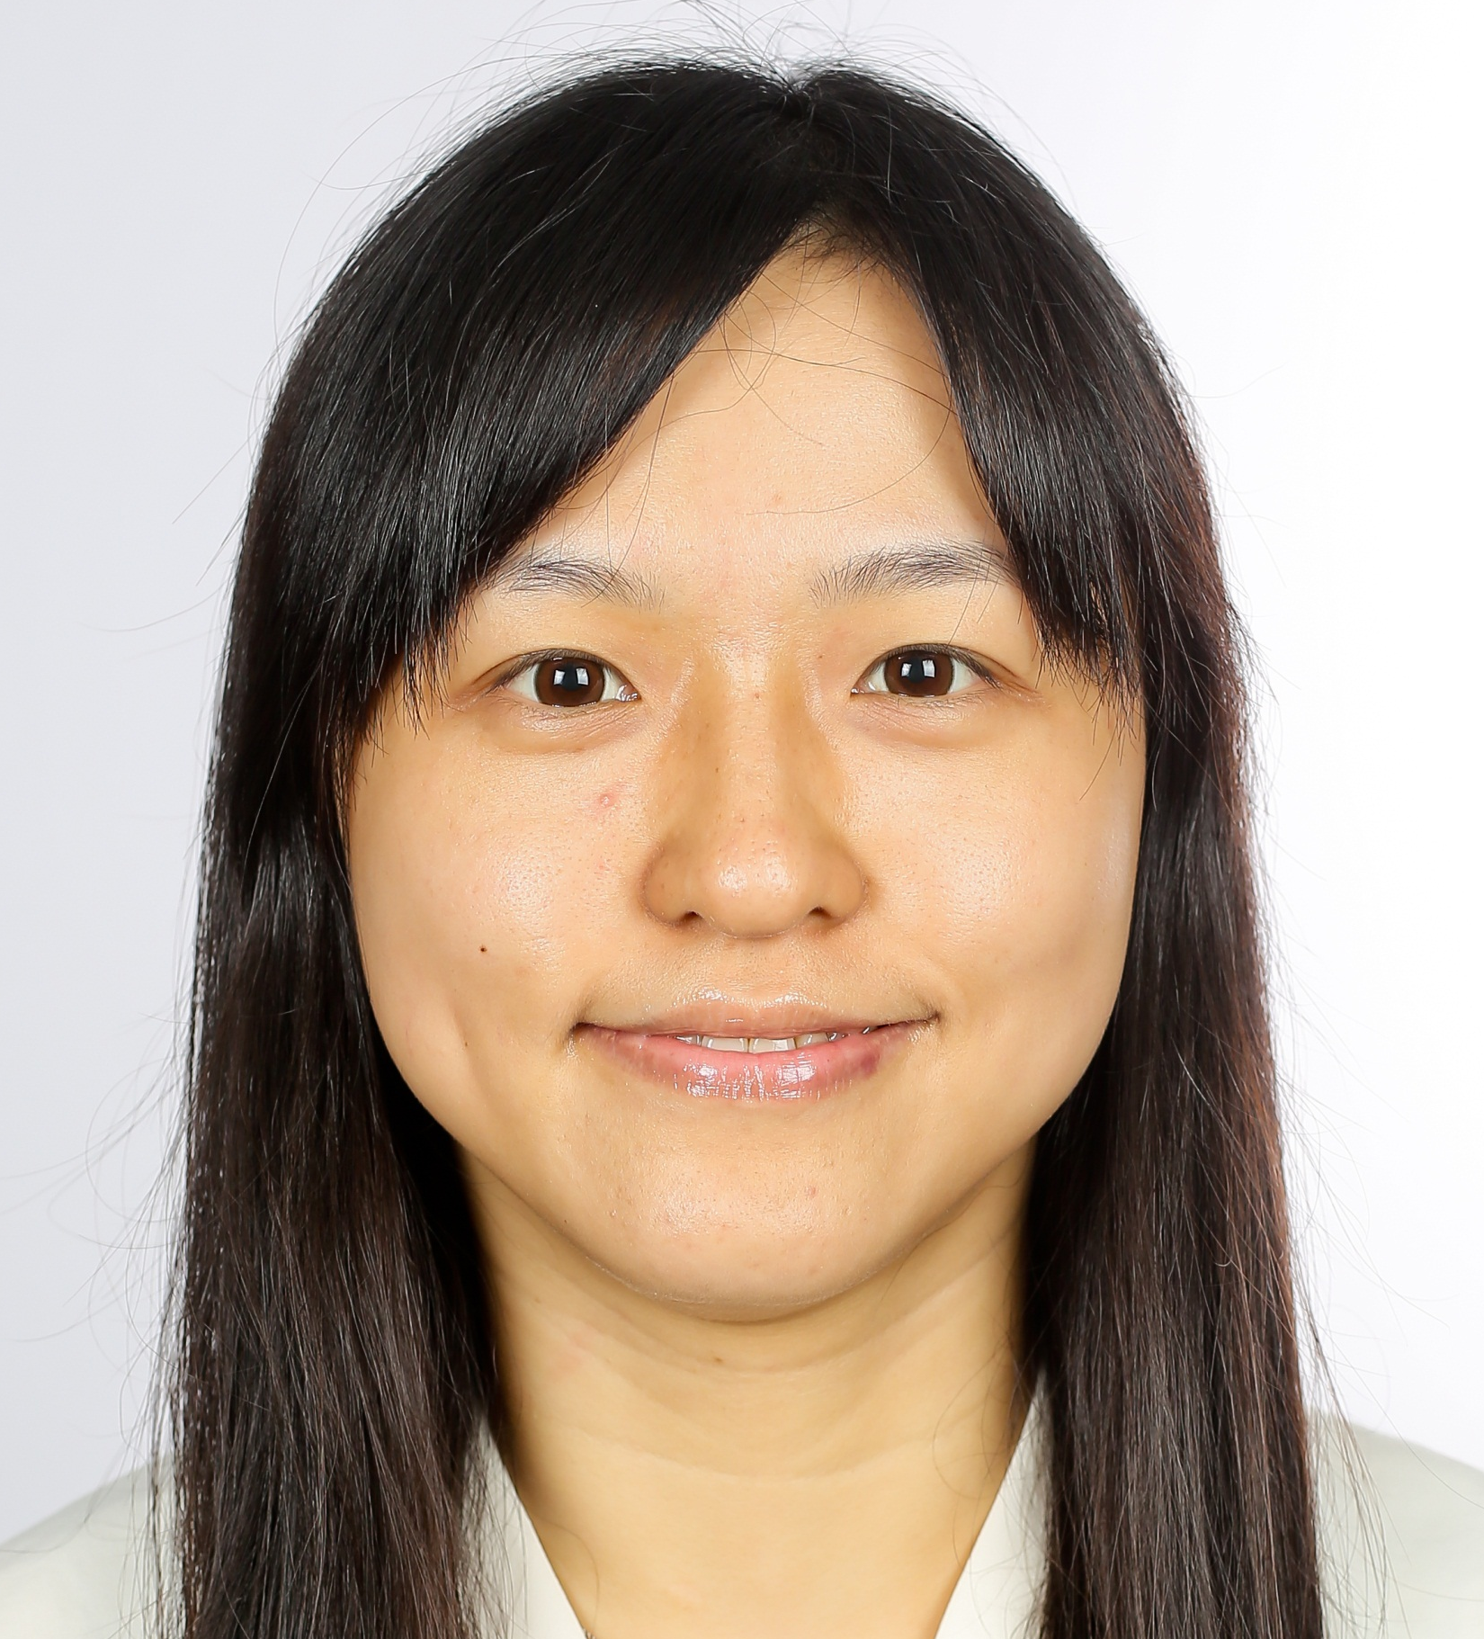

Slide 35
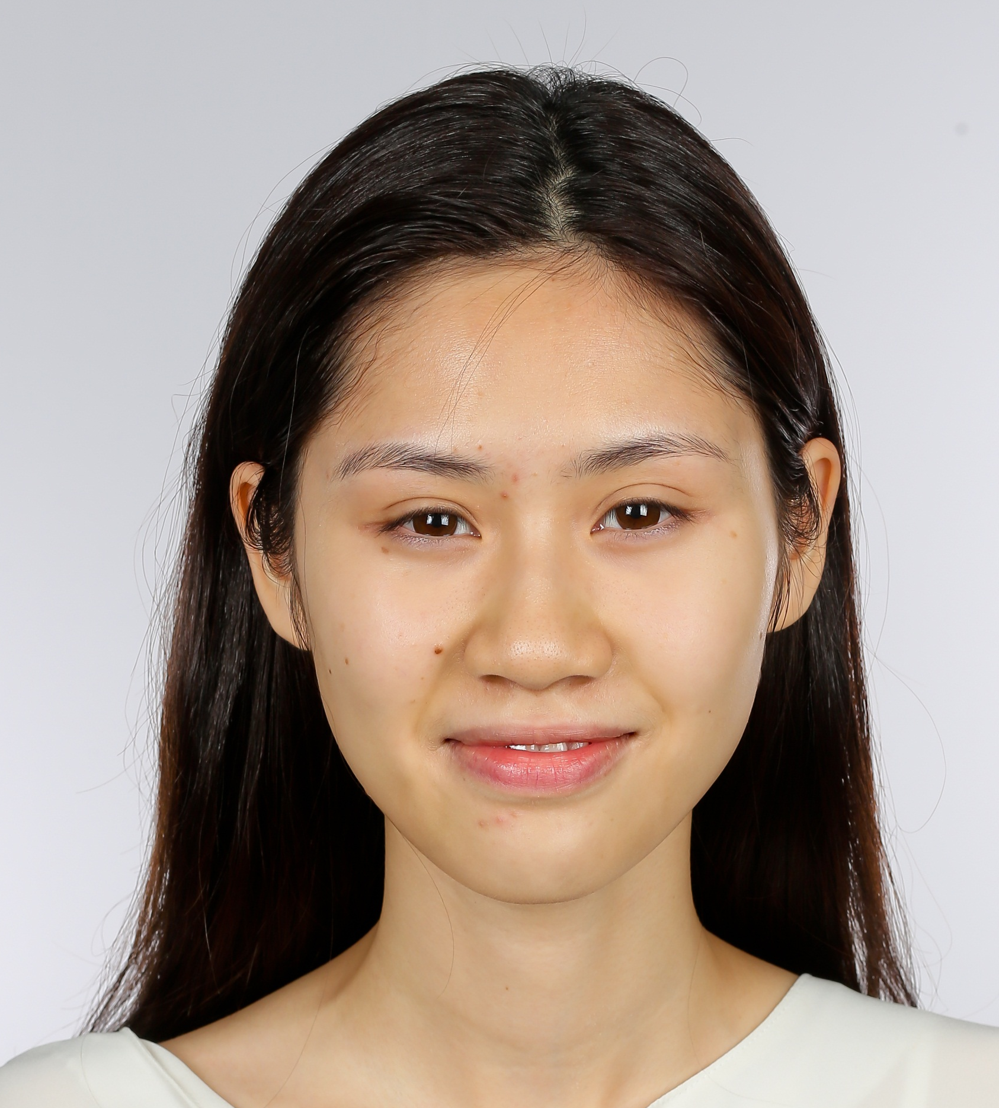

Slide 36
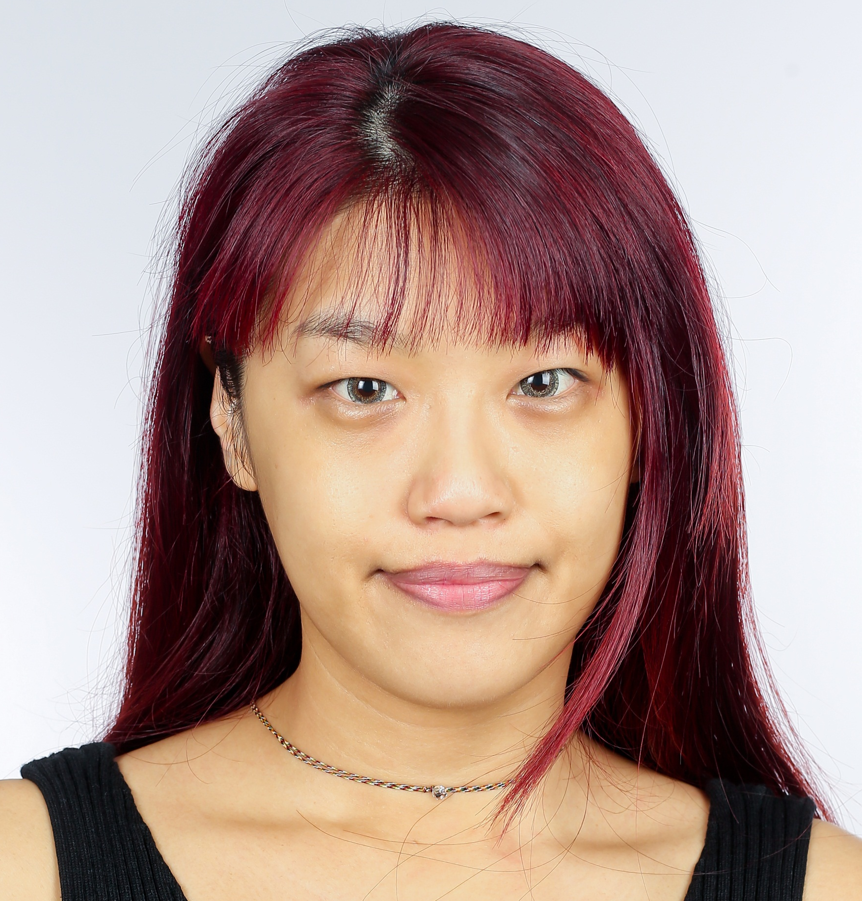

Slide 37
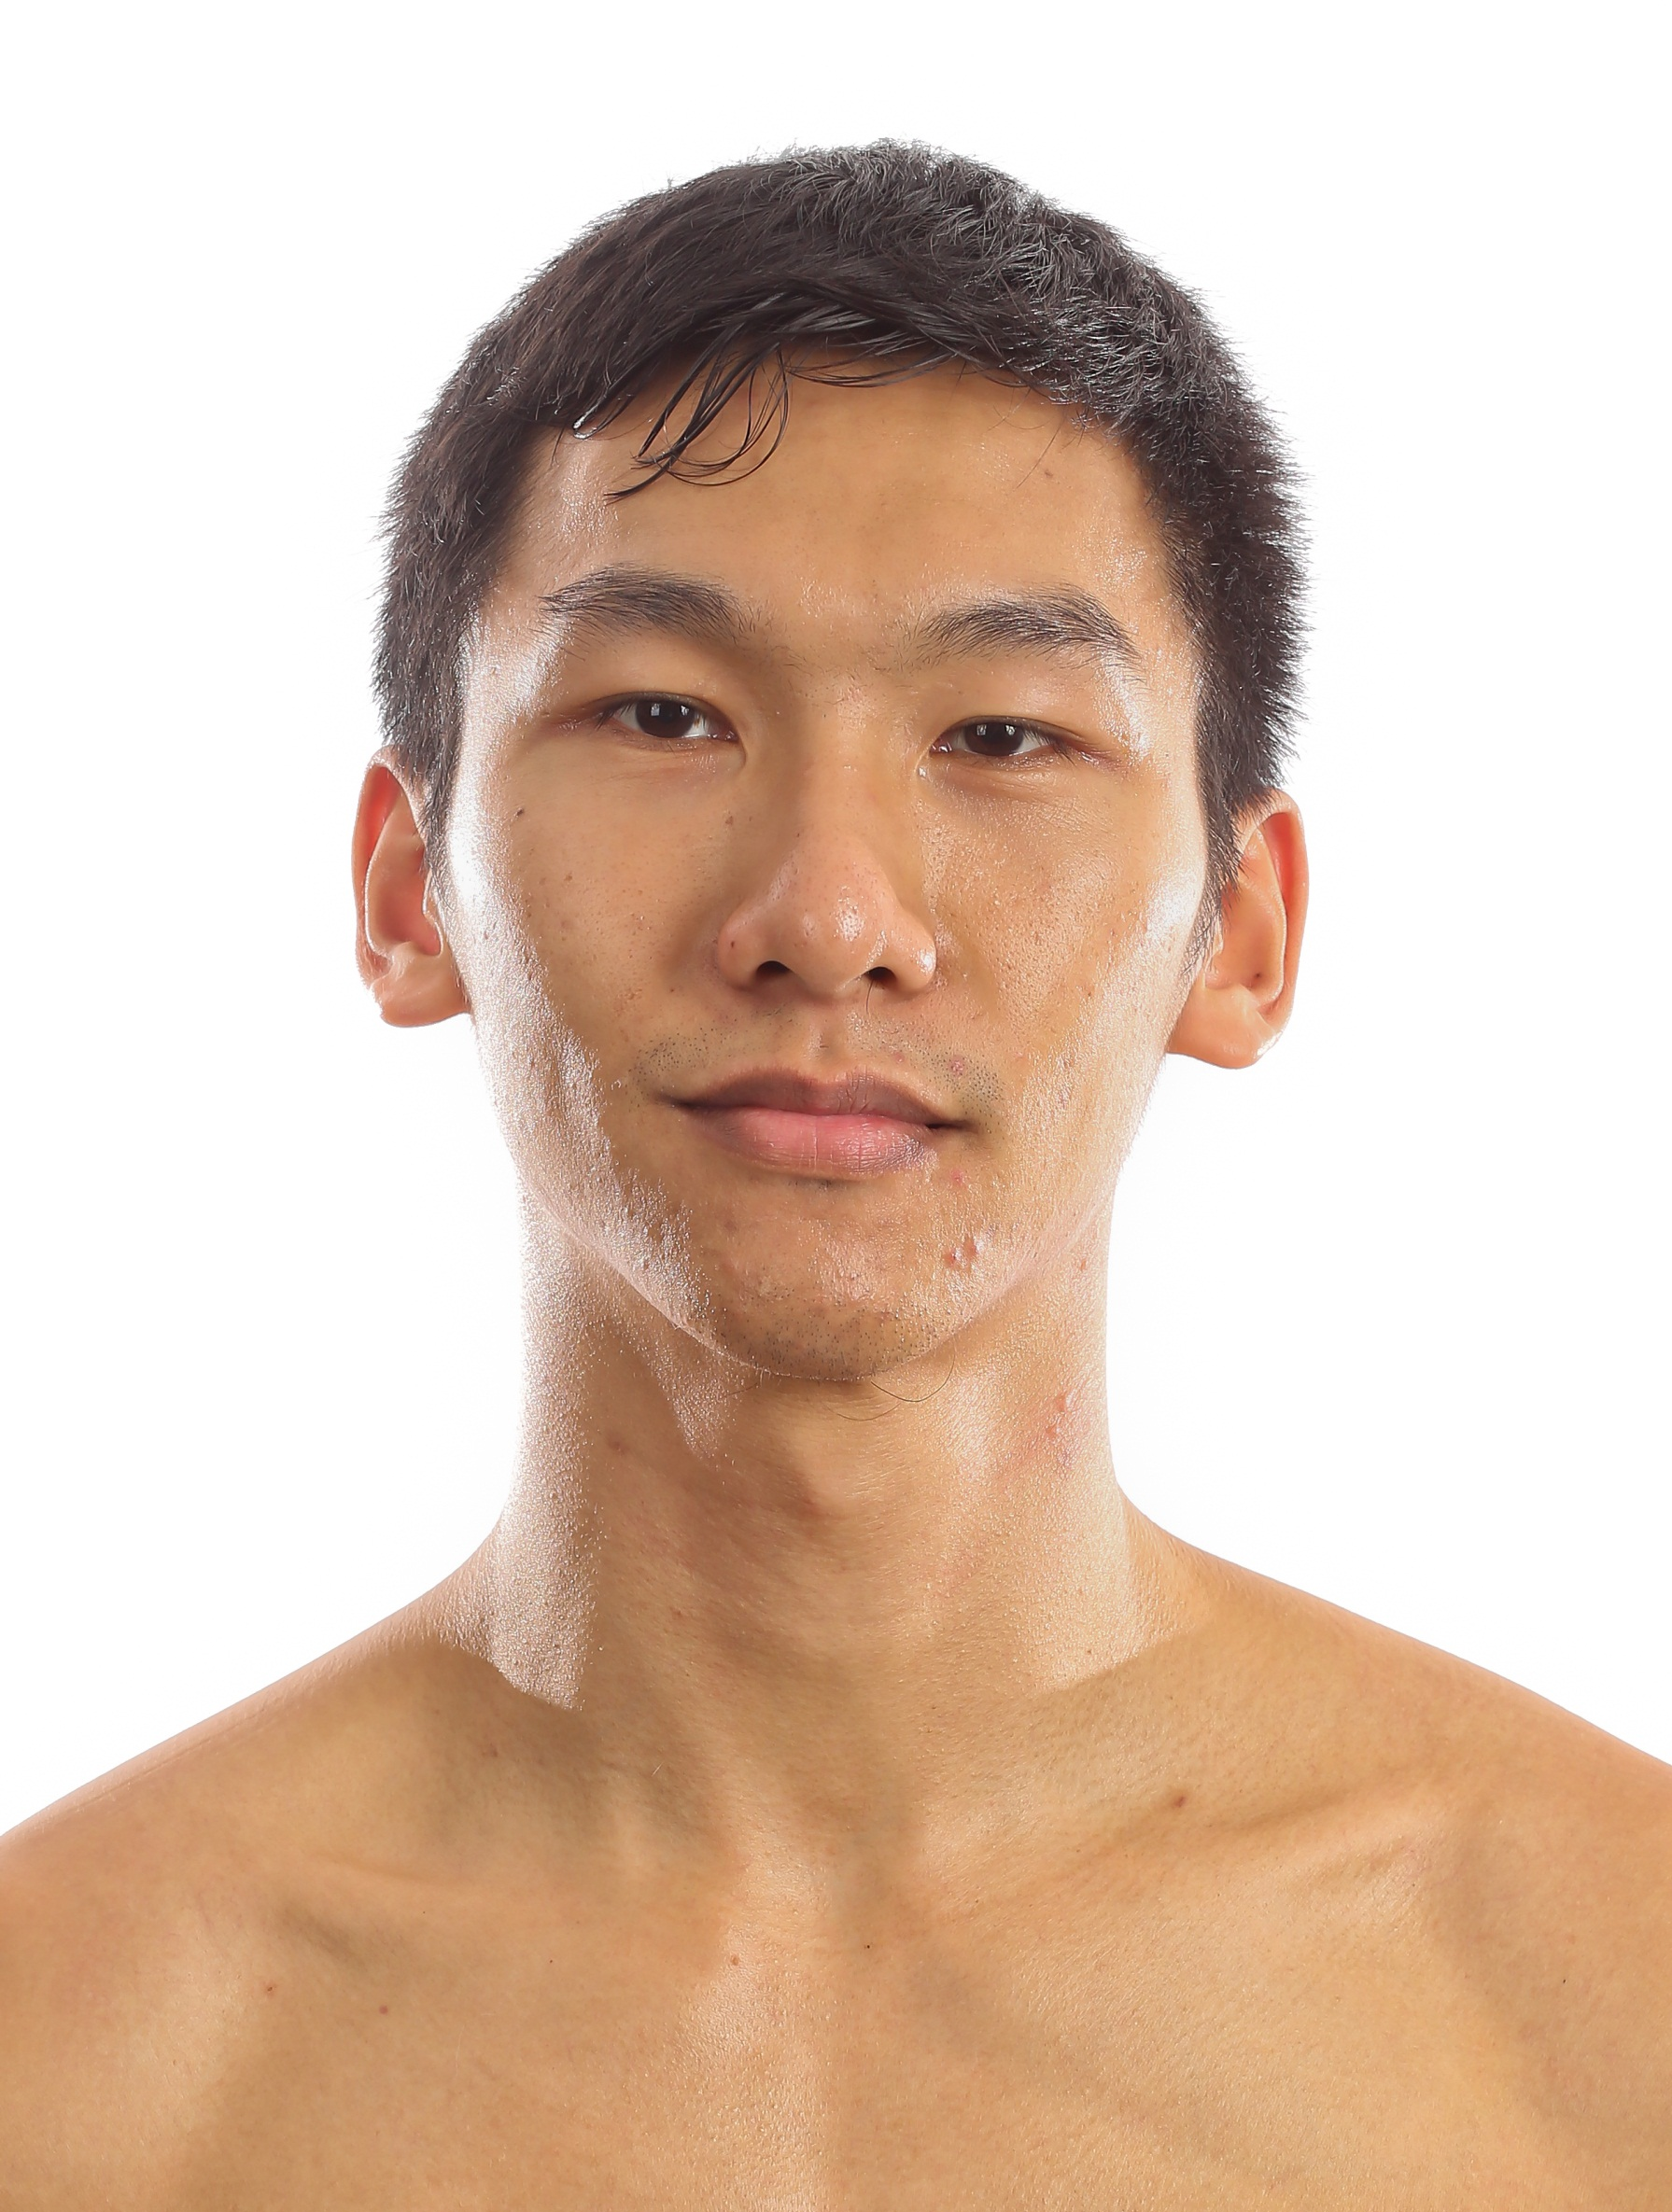

Slide 39
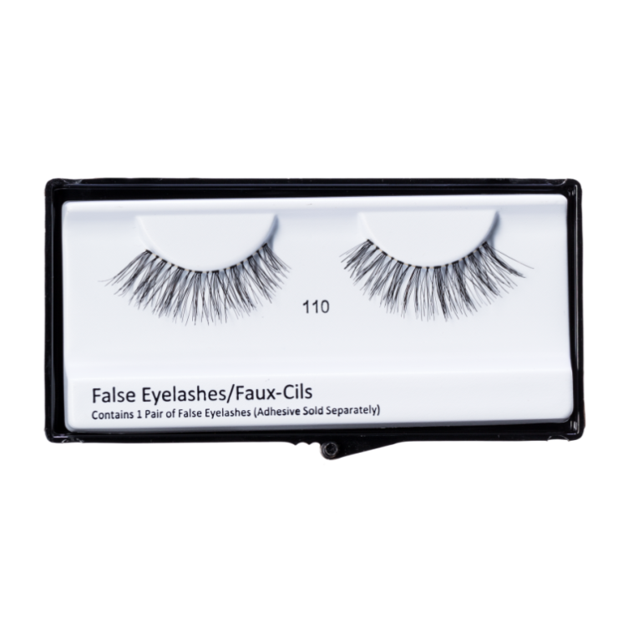
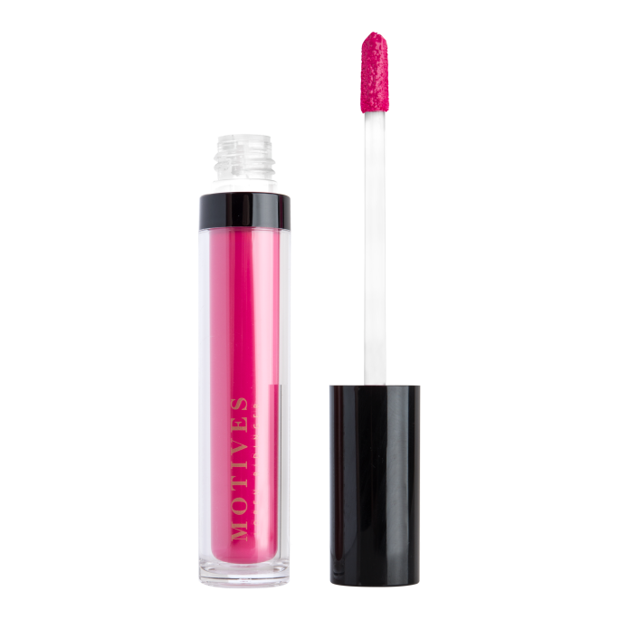
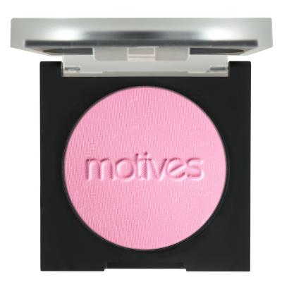
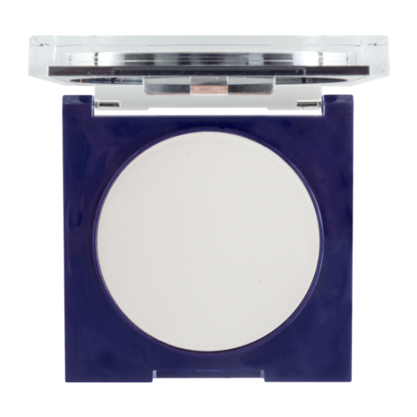
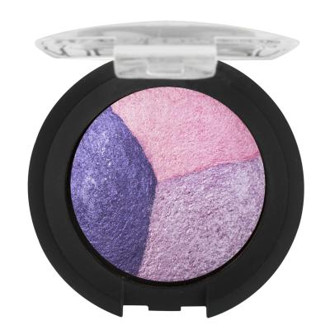

Slide 40
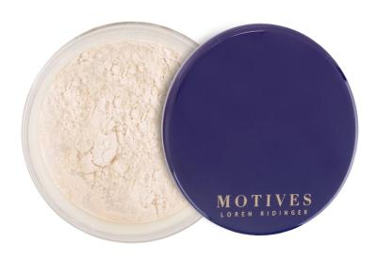
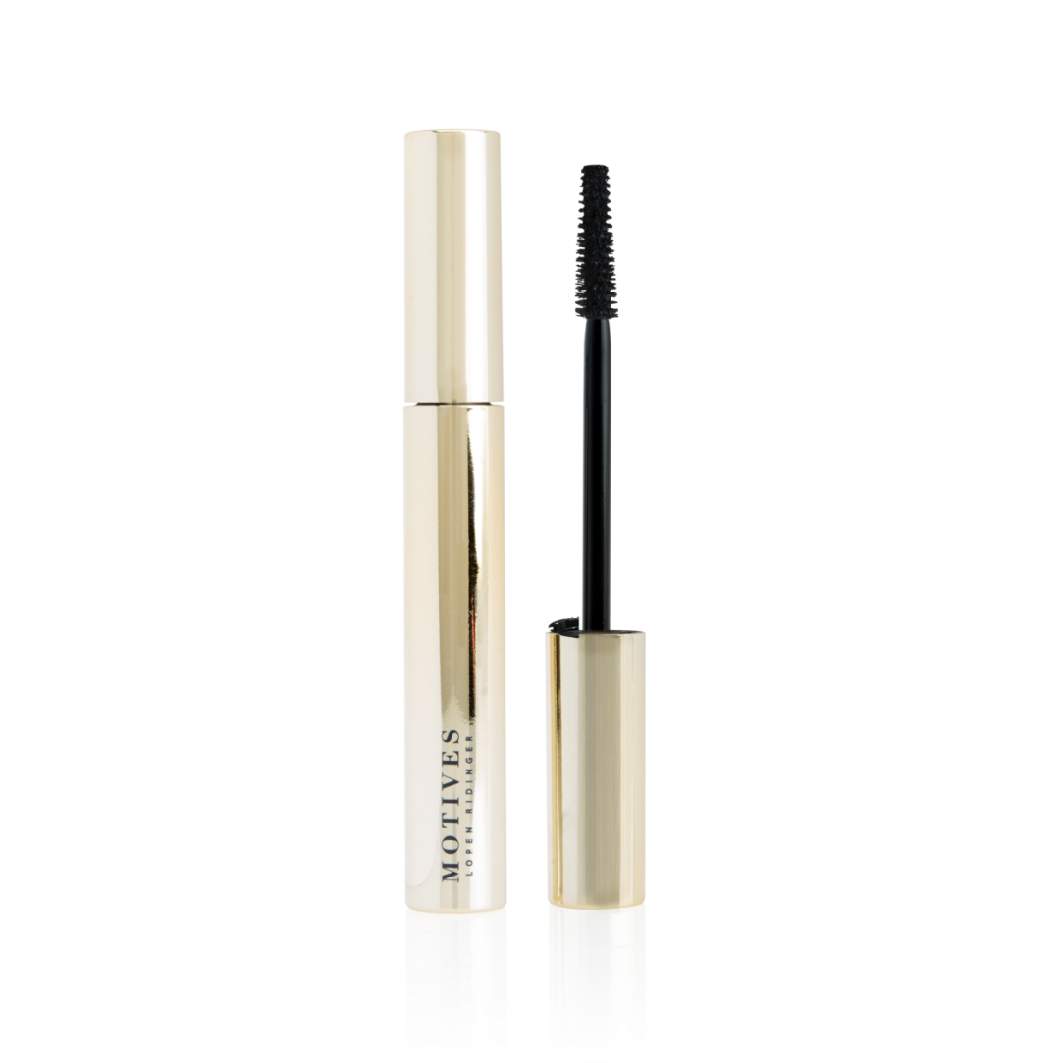
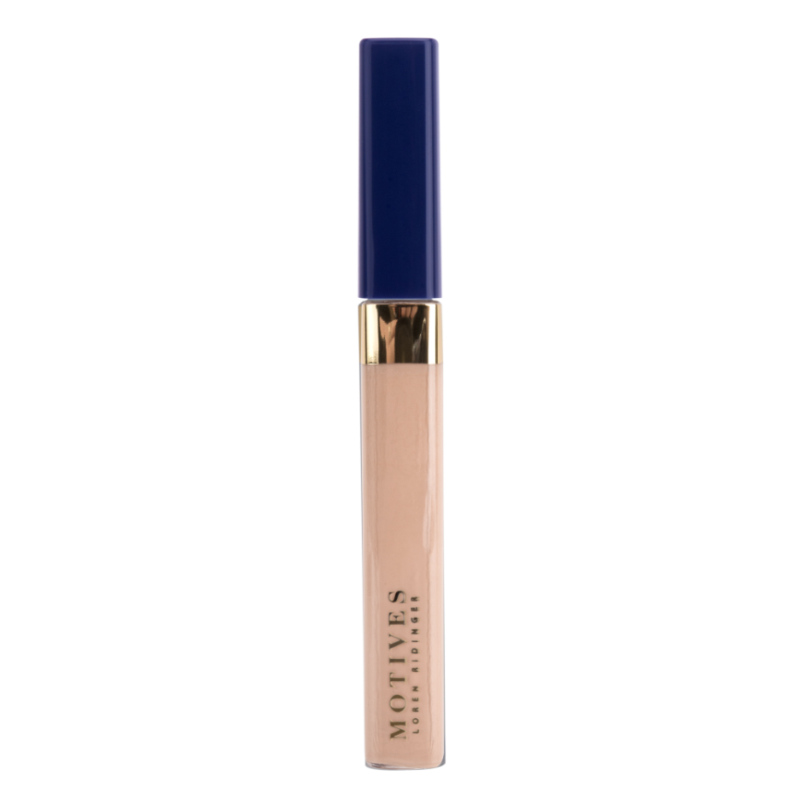

Slide 41
